Slide 1


OPTIMIZING USER EXPERIENCE AN IN-DEPTH LOOK AT ATM SIMULATION SYSTEM
KM Haneef
Guided By
K Velumurugan
CSA0912
JAVA PROGRAMMING
192211905

Slide 2

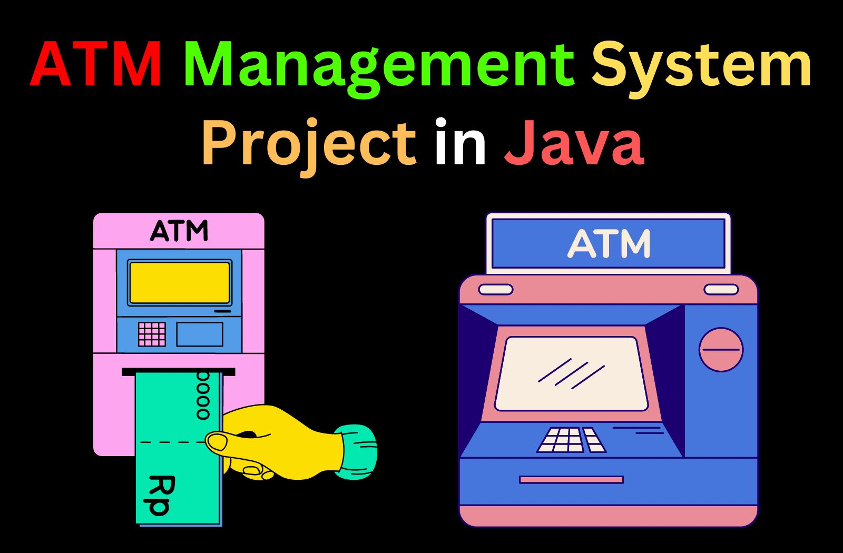
Abstract
Secure login mechanisms, such as PIN and biometric authentication, to ensure user identity verification and protection of sensitive data.
Real-time processing and updating of transactions to maintain accurate account balances and provide instant feedback to users.
Development of an intuitive and user-friendly graphical interface to facilitate smooth and efficient user interactions with the system.

Slide 3
Introduction
Implementing secure login mechanisms (e.g., PIN, biometric authentication) and encryption protocols to ensure the protection of user credentials and sensitive data
Providing essential banking operations such as cash withdraw, balance inquiry, fund transfer, and mini-statement generation to simulate real ATM functionalities.

Slide 4
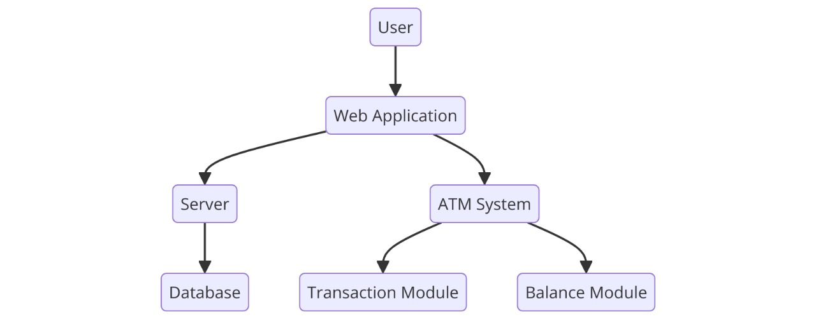
Architecture Diagram
User Interaction:
The system starts with the user, who interacts with the web application to access ATM services.
Web Application as an Interface:
The web application serves as the interface through which users interact with the ATM system and other components.
Backend Components:
Server: Handles the communication between the web application and the database, managing user data, account information, and transaction history.

Slide 5
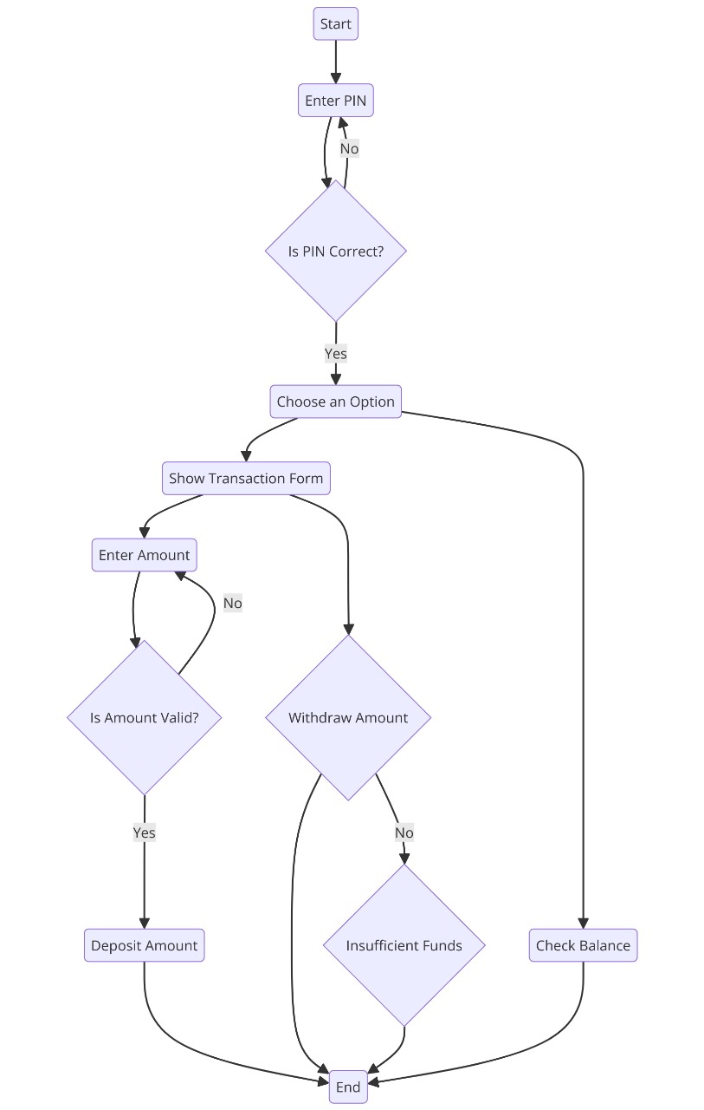
Flow Chart
Start of Transaction:
The process begins with the user starting the transaction and entering their Personal Identification Number (PIN).
PIN Verification:
The system checks if the entered PIN is correct. If the PIN is incorrect, the user is prompted to re-enter the PIN.
Options Selection:
Once the PIN is verified, the user is presented with options to choose from, such as withdrawing cash, checking balance

Slide 6
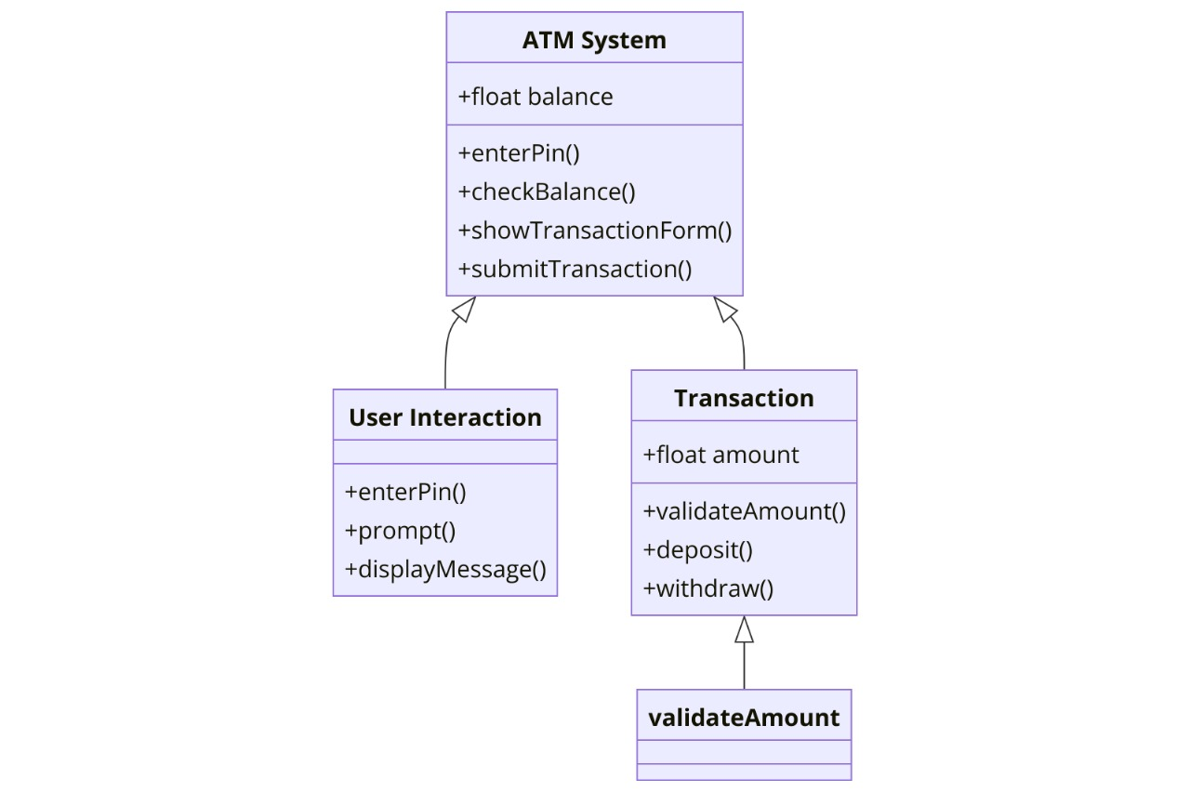
Class Diagram
Classes and Attributes:
ATM System: Central class representing the ATM system with attributes and methods for handling core ATM functions.
Attribute: +float balance
Methods: +enterPin(), +checkBalance(), +showTransactionForm(), +submitTransaction()
User Interaction Class:
Represents the interaction layer between the user and the ATM system.
Methods: +enterPin(), +prompt(), +displayMessage()
Responsible for handling user inputs and displaying appropriate messages or prompts to the user.

Slide 7
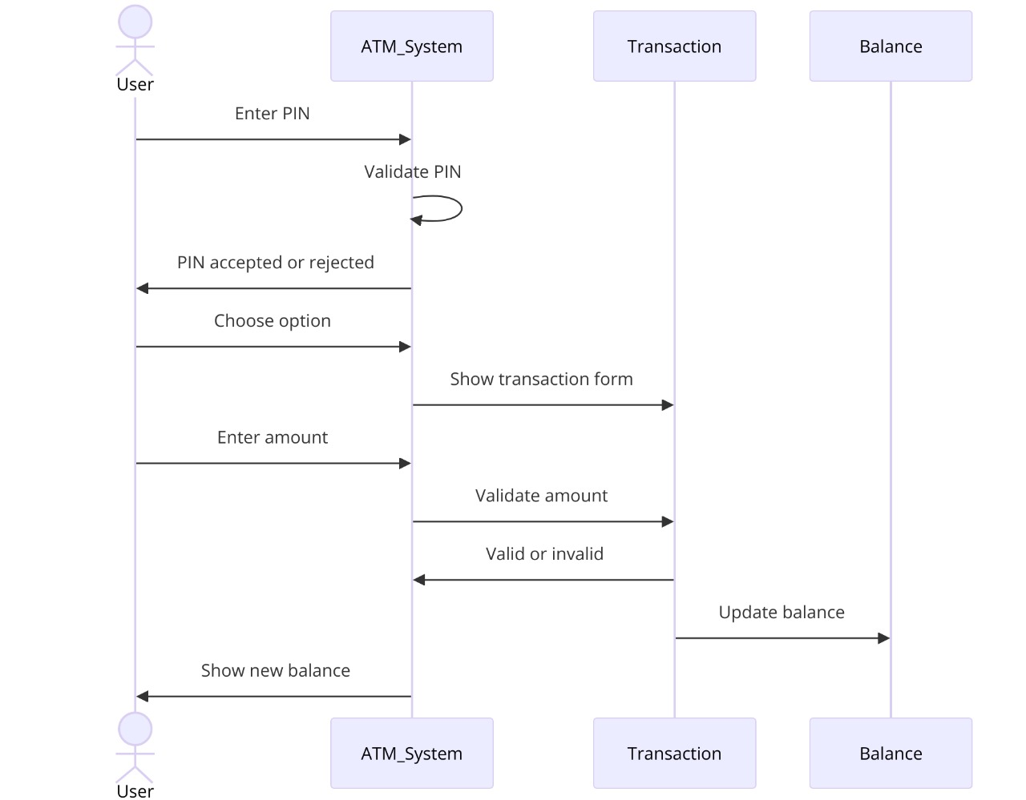
UML Chart
Sequential Flow: The sequence diagram shows the order in which messages and interactions occur between the user, ATM system, transaction, and balance components. Loop and Conditional Logic: The diagram depicts a loop for PIN validation and a decision point for accepting or rejecting the PIN. Validation Steps: The ATM system includes multiple validation steps, such as checking the PIN and ensuring the transaction amount is valid, ensuring security and accuracy.
Separation of Concerns: Different components handle different responsibilities: the ATM system interacts with the user, the transaction component manages transaction logic, and the balance component deals with account balance

Slide 8
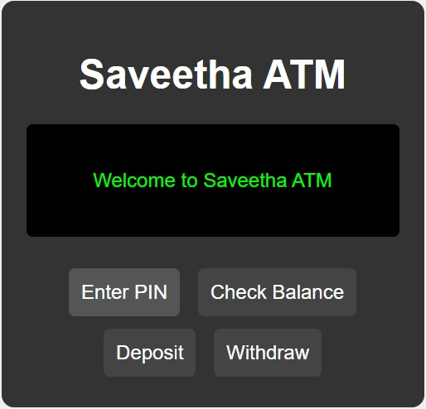

Result Screenshot
Login Interface

Slide 9
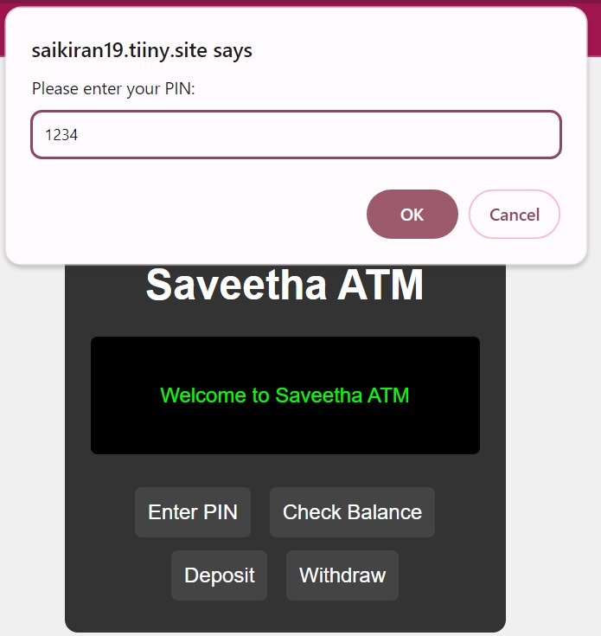
Result Screenshot
Entering Pin

Slide 10
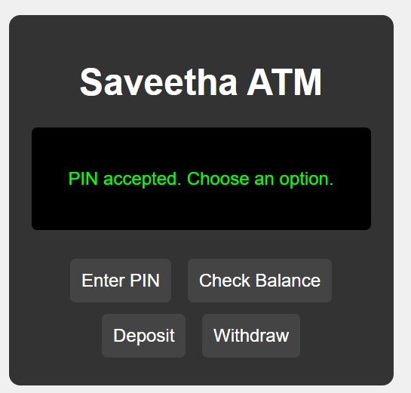
Result Screenshot
Pin Accepted

Slide 11
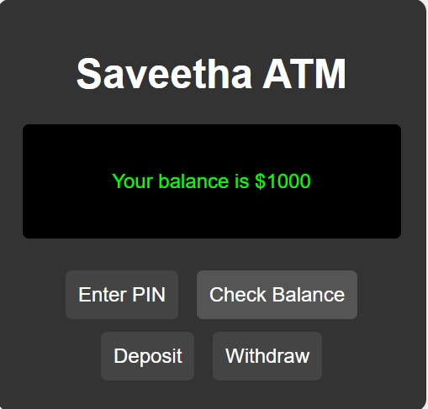
Result Screenshot
Checking Balance

Slide 12
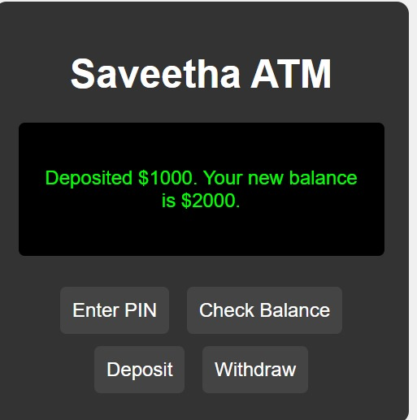
Result Screenshot
Deposit Money

Slide 13
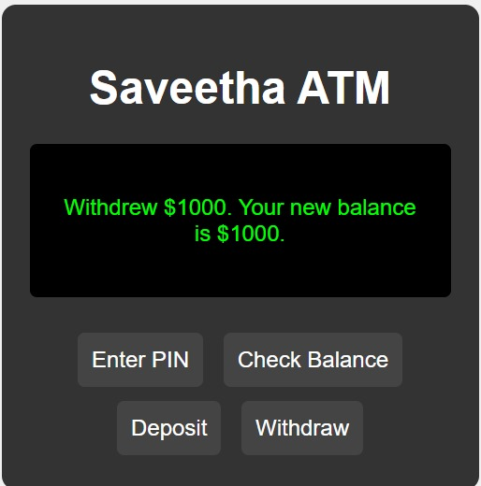
Result Screenshot
Withdraw Money

Slide 14


Conclusion
The ATM Simulation System effectively replicates the functionality of a real-world Automated Teller Machine, providing a secure and user-friendly platform for conducting essential banking transactions. By incorporating robust user authentication methods and implementing core features such as balance inquiries, cash withdrawals, and deposits, the system ensures both security and convenience for users. The modular design, consisting of distinct components for user interaction, transaction management, and validation, enhances the system's maintainability, scalability, and efficiency.

